Slide 1
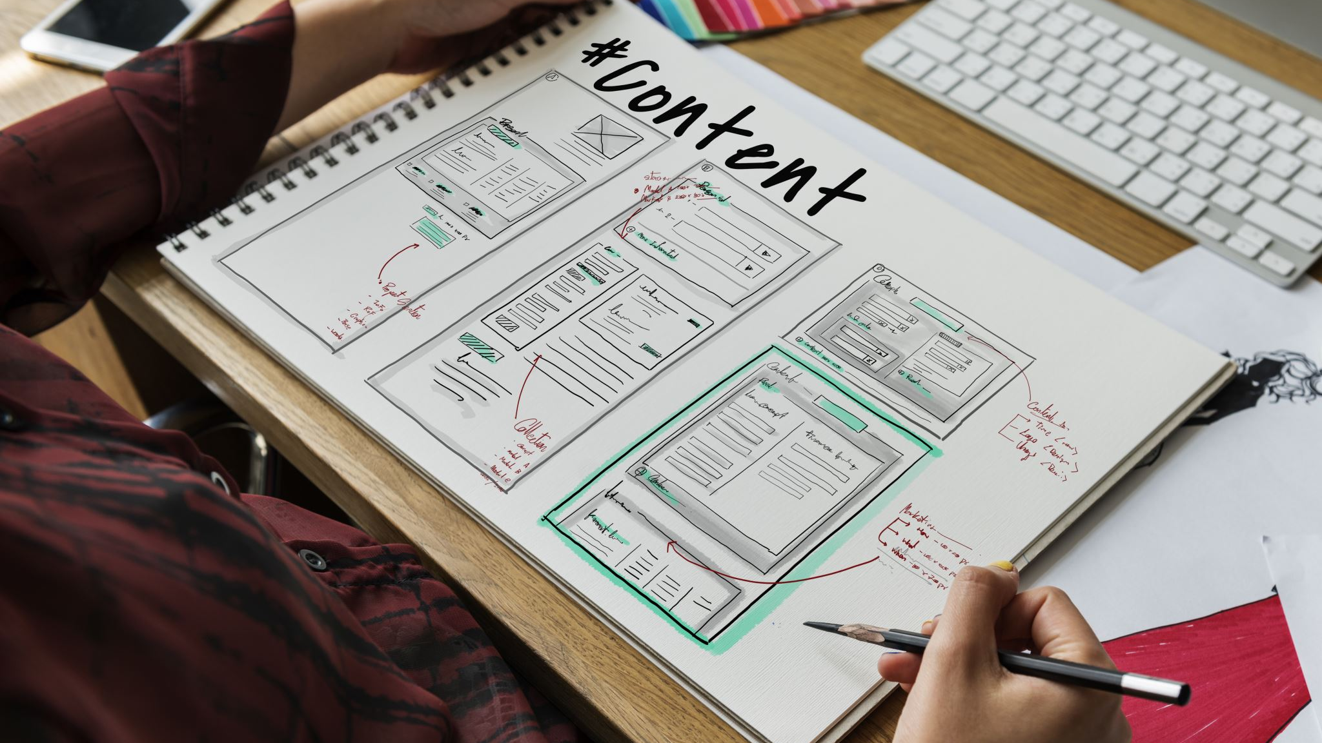
Building a Social Media Website with the MERN Stack

Slide 2

Introduction
In the ever-evolving digital landscape, social media websites have become an integral part of our lives
This project aims to guide you through the process of creating a social media website using the MERN stack
We'll cover each step, from setting up the backend to deploying the final product

Slide 3

Overview of MERN Stack
MongoDB: A NoSQL database for flexible data storage
Express.js: A back-end framework for building APIs and handling server-side logic
React: A JavaScript library for building dynamic, interactive user interfaces
Node.js: A JavaScript runtime for server-side development

Slide 4
Project Goals
Create a social media website that allows users to sign up, log in, and interact with each other
Implement user authentication and authorization
Develop a user profile system
Build a post feed where users can share updates
Enhance interactivity and engagement with features like likes, comments, and notifications
Ensure mobile responsiveness for a seamless user experience
Test and debug the application thoroughly
Deploy the website to a production environment
Address challenges and consider future improvements
Prioritize security throughout the development process

Slide 5
Setting Up the Backend
Create a Node.js project
Set up Express.js for routing and handling HTTP requests
Implement user registration, login, and authentication
Create API routes for user profiles, posts, comments, and interactions

Slide 6
Database Design
Design the MongoDB schema to store user data, posts, comments, and relationships
Establish data models and define relationships between collections
Implement database CRUD operations using Mongoose or a similar library
reltionships

Slide 7

Building the Front End
Initialize a React application
Develop the user interface using components
Create forms for user registration, login, and profile management
Implement components for displaying user profiles, posts, and comments
Add interactivity and real-time updates for likes, comments, and notifications
Ensure smooth navigation with React Router

Slide 8
User Authentication
Implement user authentication using JWT or a similar method
Handle user sessions and protect routes
Implement password hashing for security

Slide 9
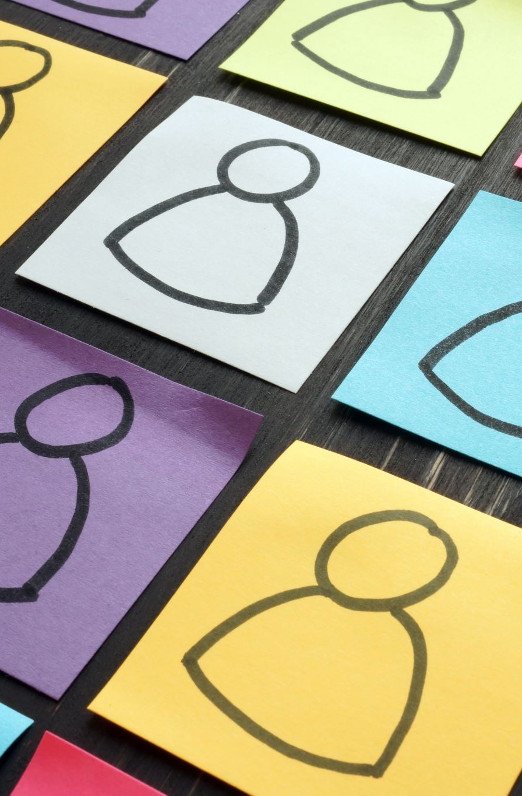
Creating User Profile
Develop user profile pages with information and activity feeds
Allow users to update their profiles, including avatars and bios

Slide 10
Building the Post Feed
Create a feed where users can create, view, and interact with posts
Implement features like liking, commenting, and sharing
Support multimedia content such as images and videos

Slide 11
Interactivity and Engagement
Implement real-time features using WebSockets or server-sent events
Notify users of new likes, comments, and mentions
Enhance engagement with features like hashtags and trending topics

Slide 12

Mobile Responsiveness
Ensure the website is responsive and user-friendly on mobile devices
Implement responsive design principles using CSS or a UI framework

Slide 13
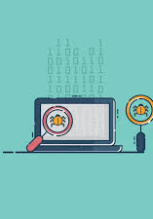
Testing and Debugging
Write unit tests and integration tests for both the backend and frontend
Use testing libraries like Jest, Mocha, and React Testing Library
Debug and resolve issues as they arise

Slide 14
Deployment
Deploy the backend and frontend to production servers or cloud platforms
Set up domain and DNS configurations
Optimize the application for production, including performance and security considerations

Slide 15

Challenges and Future Improvements
Challenges may include scalability, handling large amounts of data, and ensuring a smooth user experience
Future improvements could involve machine learning for content recommendations, enhanced privacy settings, and integration with other social platforms

Slide 16

Security
Security should be a top priority
Implement best practices for data validation, user input sanitization, and protection against common web vulnerabilities like Cross-Site Scripting and SQL Injection

Slide 17
Conclusion
Building a social media website using the MERN stack is a rewarding endeavor, but it's essential to approach it systematically and with a focus on security and user experience
By following these steps and continuously improving your application, you can create a robust and engaging platform for users to connect and share

